Slide 1
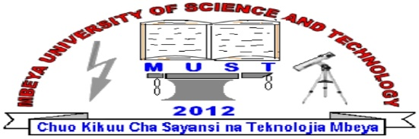
COURSE CODE: IT6116
COURSE NAME: BASIC COMPUTER APPLICATION
FACILITATOR: JOYCE FRED

Slide 2
LECTURE ONE
Introduction to Computer

Slide 3
Information Processing System
DATA is a collection of independent and unorganized facts.
INFORMATION is the processed and organized data presented in a meaningful form.
DATA PROCESSING is the course of doing things in a sequence of steps

Slide 4
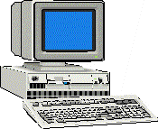
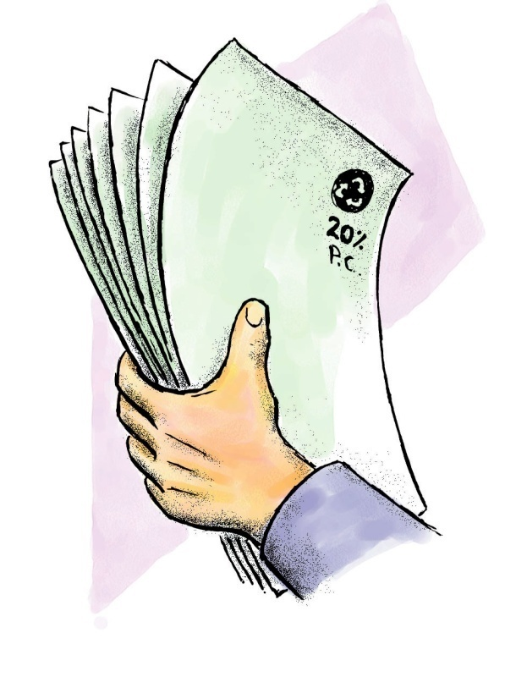
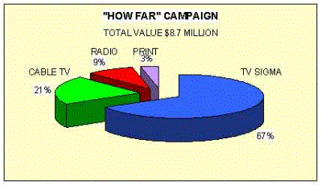
PROCESSING SYSTEM
INFORMATION
DATA

Slide 5
What is a computer?
A computer is an electronic device, operating under the control of instructions stored in its own memory that can accept data (input), process the data according to specified rules, produce information (output), and store the information for future use.

Slide 6
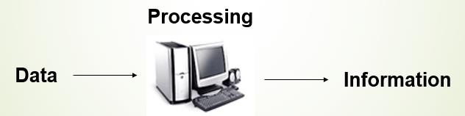
Functionalities Of A Computer

Slide 7
Takes Data as Input
Stores the data/Instructions in its memory and use them when required.
Processes the data and coverts it into useful Information.
Generates the Output.
Control all the above four steps.

Slide 8
Computer Components
Any kind of a computer consists of:
Hardware Components
Software Components
Peopleware Components

Slide 9
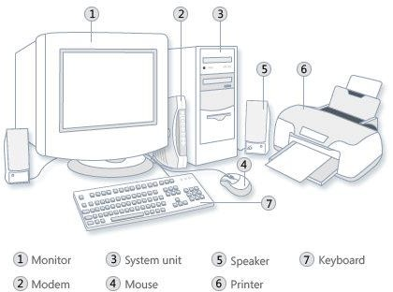
A.Hardware
Computer hardware is the collection of physical elements that constitutes a computer system. Computer hardware refers to the physical parts or components of a computer such as the monitor, mouse, keyboard, computer data storage, hard drive disk (HDD) etc. all of which are physical objects that can be touched.

Slide 10
Components of Computer hardware:
Input Devices
Processing Device
Output Devices
Storage Devices

Slide 11
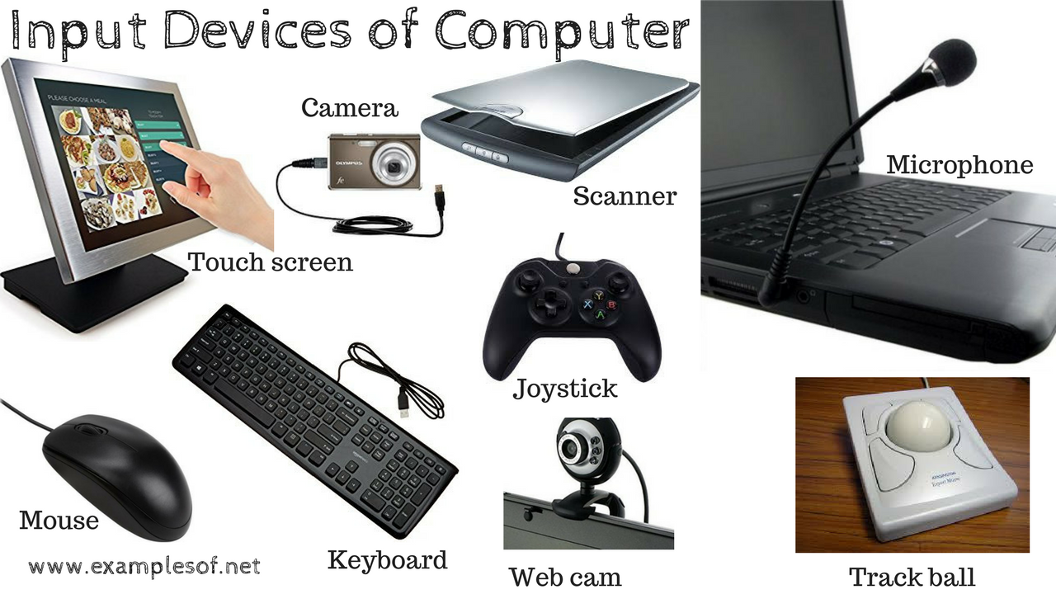
Input Devices
The data that is given to the computer is called Input. Input devices are used to input data and instructions into the computer. These devices send this data to the Processing Unit.

Slide 12
Processing Device
The Processor is used to process data. It is also called Central Processing Unit (CPU). It is the brain of the computer. It consists of electronics circuit. CPU interprets and executes program instructions. All computers must have a Central Processing Unit.
The CPU is comprised of three main parts :
1. Arithmetic Logic Unit (ALU): Executes all arithmetic and logical operations. Arithmetic calculations like as addition, subtraction, multiplication and division. Logical operation like compare numbers, letters, or special characters

Slide 13
2. Control Unit (CU): controls and co-ordinates computer components.
Read the code for the next instruction to be executed.
Increment the program counter so it points to the next instruction.
Read whatever data the instruction requires from cells in memory.
Provide the necessary data to an ALU or register.
If the instruction requires an ALU or specialized hardware to complete, instruct the hardware to perform the requested operation.
3. Registers :Stores the data that is to be executed next, "very fast storage area".

Slide 14
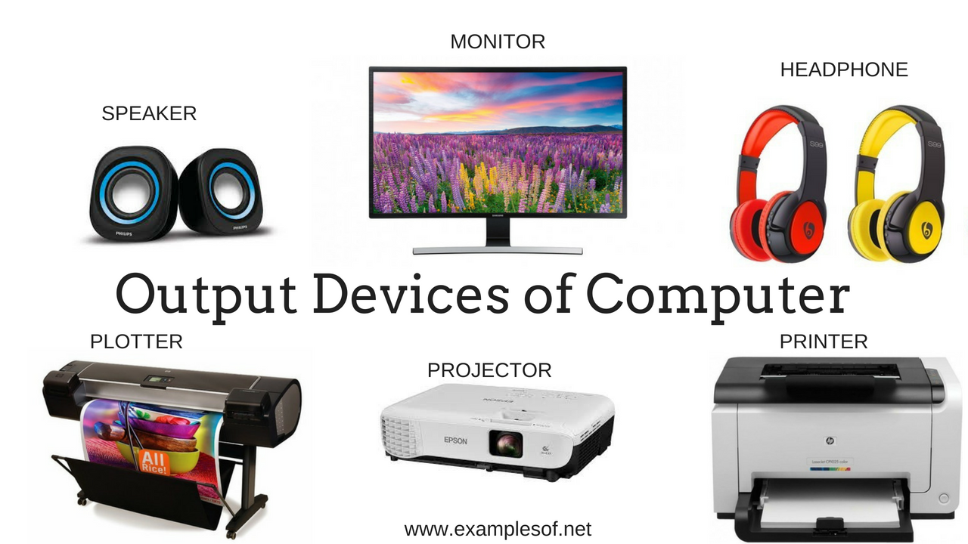
Output Devices
The data processed into useful information is called output. Output devices are used to display the result of processing.

Slide 15
Storage Devices
These are devices whereby a computer store instruction, programs or information for future use.
MEMORY
Is the electronic holding place for the instructions and data a computer needs to reach quickly.
Two types of computer memory are primary and secondary.
NB: There is a difference between memory and storage, Memory is primary memory while storage is secondary memory i.e Memory refers to the location of short-term data, while storage refers to the location of data stored on a long term basis.
The main memory stores data and programs temporary & is called Primary Storage. The Secondary storage is required to store Data , Information and Programs permanently.

Slide 16
Primary Memory
RAM: Random Access Memory (RAM) is a memory scheme within the computer system responsible for storing data on a temporary basis, so that it can be promptly accessed by the processor as and when needed. It is volatile in nature, which means that data will be erased once supply to the storage device is turned off.
ROM (Read Only Memory): ROM is a permanent form of storage. ROM stays active regardless of whether power supply to it is turned on or off. ROM devices do not allow data stored on them to be modified.

Slide 17
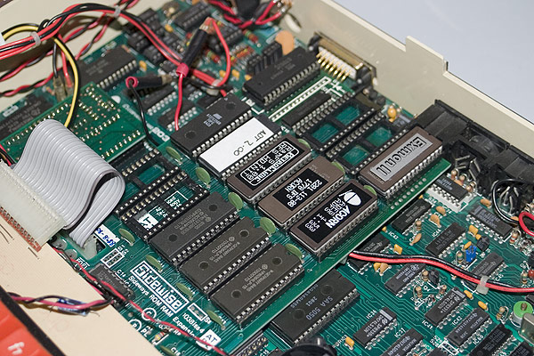
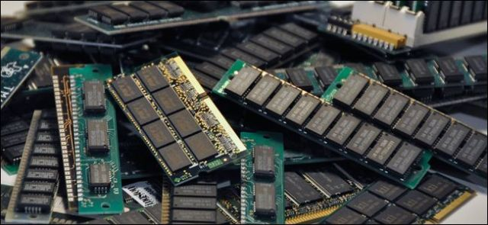
RAM
(Random Access Memory)
ROM
(Read Only Memory)

Slide 18
Secondary Memory
Stores data and programs permanently: its retained after the power is turned off
Hard drive (HD): A hard disk is part of a unit, often called a "disk drive," "hard drive," or "hard disk drive," that store and provides relatively quick access to large amounts of data on an electromagnetically charged surface or set of surfaces.
Optical Disk: an optical disc drive (ODD) is a disk drive that uses laser light as part of the process of reading or writing data to or from optical discs. Some drives can only read from discs, but recent drives are commonly both readers and recorders, also called burners or writers

Slide 19
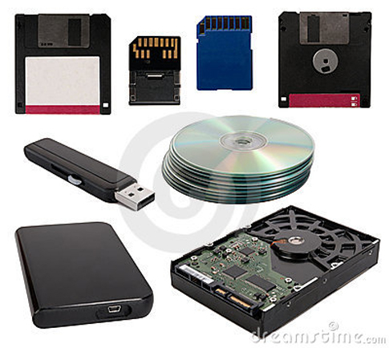

Slide 20
B.Software
Software is a set of electronic instructions that tells the computer how to do certain tasks. A set of instructions is often called a program.
When a computer is using a particular program, it is said to be running or executing the program.
The two most common types
System software
Application software.

Slide 21
I. System software
System software exists primarily for the computer itself, to help the computer perform specific functions.
One major type of system software is the operating system (OS). All computers require an operating system.
The OS tells the computer how to interact with the user and its own devices.
Common operating systems include Windows, the Macintosh OS, OS/2, and UNIX .

Slide 22
II. Application software.
Application software tells the computer how to accomplish tasks the user requires, such as creating a document or editing a graphic image.
Some important kinds of application software are:
Word processing programs Spreadsheet software
Database management Presentation programs
Graphics programs Networking software
Web design tools and browsers Internet applications
Communications programs Utilities
Entertainment and education Multimedia authoring

Slide 23

C. Peopleware
People are the computer's operators, or users.
Some types of computers can operate without much intervention from people, but personal computers are designed specifically for use by people

Slide 24
Thank you

